Slide 1
Pinned! Mobile App Design
Cody Mattern, Anna Shea
Kyle Giacomini, Tyler Albee

Slide 2
Tools Used
Trello
Project Tracker
Was mainly used to visualize and grant a universal understanding of tasks to be done and in what order.
Visual Studio/Xamarin Studio
IDE
Served in development, testing GUI and front end integration(via emulation), and deployment.
Complexity of software did cause various issues.
Xamarin integration in VS 15 caused slow downs due to xamarin only partially working (VS 17 launched in the middle of the semester).
OSX
Required for IOS emulation
Only problem this caused was financial barrier to entry, otherwise we had better luck building for IOS than android.
Github
VCS
Did not cause any major problems throughout project.
MySQL
Database
Much like github, it worked as intended.
Doxygen
Auto-documentation utility

Slide 3
Methodologies
Agile
Focused on building and integrating single functionality at a time.
Pair Programmed when possible
Due to the widely varied experience throughout the group more experienced group members aided the less experienced members with programming were possible.
Found ourselves with few opportunities to do this due to busy schedules all around.

Slide 4
Challenges (IOS Frontend)
Xamarin documentation was confusing towards cross platform projects.
Struggled to get Native Storyboard to run initially.
When confronted with Exception errors, within iOS simulator. The editor lacked information on where the error occurred.
While Xamarin is doing a great job giving people the ability to work on iOS project through their windows desktop, the mac connector was buggy.
Overall we lost a lot of time and even code, to Xamarin/Visual Studio issues. We had to rebuild the project a 4 or 5 times. These constant setback hindered our ability to have a polished project.
Tyler and Anna used xcode to build their storyboards. Issues with importing them into xamarin.

Slide 5
Challenges (Android Frontend)
Faulty dependencies / failing to acquire through IDE
After no solution in IDE could be found ended up reacquired missing build dependencies manually.
Visual Studio 2015 integration was faulty and only partially working (2017 Launched recently)
This caused major slow downs as android frontend had to be written manually.
We did end up adopting VS 2017 which worked as intended (notably the designer mode), however we had lost a lot of time to 2015.
Integration of Google Maps API was tricky
Resolved via study of how Google API use and registration works.

Slide 6
Challenges (Backend)
Learning Node.JS. Should of used python instead.
Understanding AWS security groups was a difficult task. Couldn’t access database for a while.
Lambda lacks a lot of functionality in terms of other AWS services.
AWS CloudWatch(logs) is very difficult to navigate
Since we were using the free tier within AWS, Lambda functions constantly timed out.
This caused issues on app, that still havn’t been fixed.

Slide 7
Demo functionality
Working login
Login succesfully can query database and verify login credentials
Working User Creation
Account creation page and user confirmation(confirmation code sent to email)
Working map Display
Map is being generated via MapKit(iOS) and Google Maps(Android)
View is rendered based on location on phone/emulator
Working pin dropping
Long Press Gesture captures event
Opens simple pin details page to create Pin

Slide 8

Xamarin iOS Storyboarding: LaunchScreen.Storyboard
Upon loading, the center design will rotate and “unlock”, revealing either the Login Page (if isAuthenticated is false) or the Home Page (if isAuthenticated is true).
Notes:
Launch Page

Slide 9

Main.storyboard: isAuthenticated flag set to false
Notes:
Login Page

Slide 10
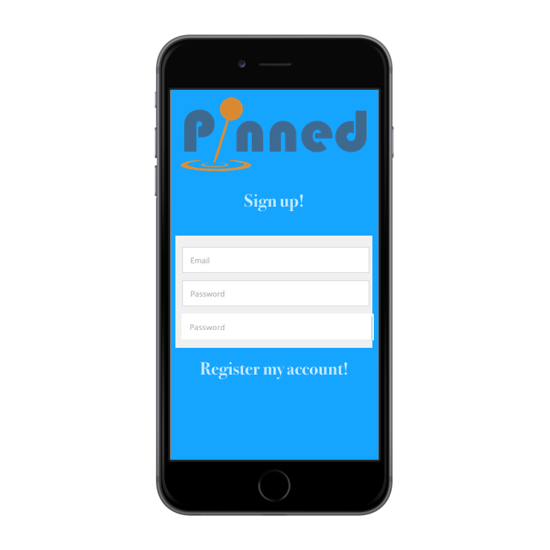
Main.storyboard: SignUp button is pressed

Slide 11
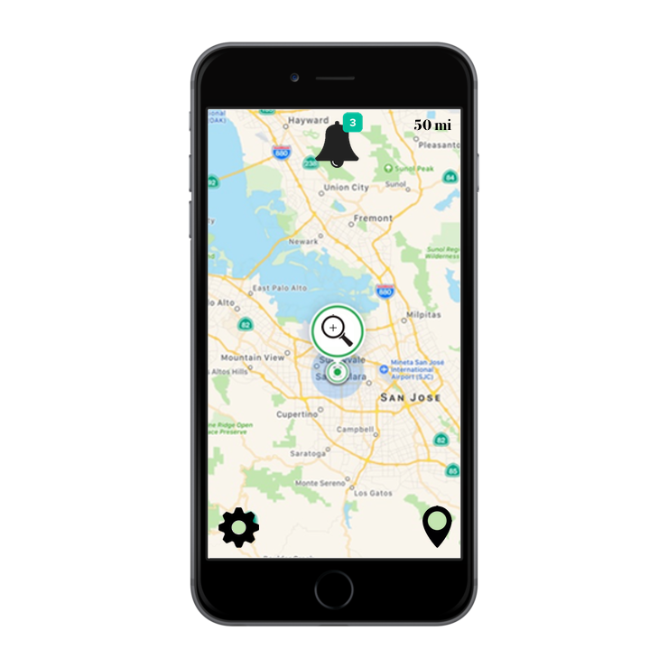
Main.storyboard: isAuthenticated flag is true

Slide 12
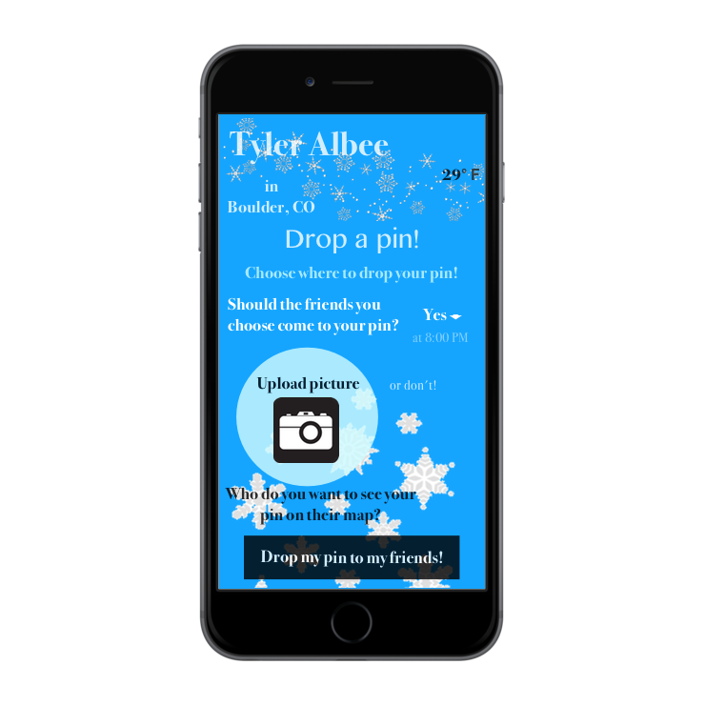
Main.storyboard: DropPin button is pressed
Dropping a pin would then upload all information and return to the updated map home page

